Slide 1
Black art of software estimation You cannot predict nor control what you cannot measure Fenton and Pfleeger, „Software Metrics“, 2nd Edition
Josip Šaban, M. Sc. computing, MBA, PMP
Erste Group IT, Vienna
Meridian Data, Zagreb
www.linkedin.com/in/josipsaban
josip.saban@erstegroup.com
meridiandatasoftware@gmail.com

Slide 2
About me
FER Zagreb ( 2004 ), Cotrugli MBA ( 2011 )
MC* ( SQL Server, Biztalk, Project Server, .NET ), MCT from 2012 until 2014
CompTIA Project+, PMP, Prince2 Foundation, ITIL Foundation
Coursera - finished 9 courses and 3 specializations (big fan☺)
Worked on vendor and client side, from startups to corporate sector, from operational to management roles
Currently working in IT department in Erste Group IT in Vienna
Also owner of sole proprietorship Meridian Data
Private interests include soccer, judging tennis and travelling

Slide 3
Lecture name origin
Lecture name taken from one of the best books in the field
MS Press - Software Estimation - Demystifying The Black Art
Other key books ( not many on this topic )
Wiley & Sons - Software Measurement And Estimation - A Practical Approach
J. Ross Publishing - Software Estimation Best Practices Tools Techniques - A Complete Guide For Software Project Estimators
Springer - Software Cost Estimation Benchmarking and Risk Assessment
Auberback - Software Sizing, Estimation, and Risk Management - When Performance Is Measured Performance Improves
ISBSG - Practical Software Project Estimation - A Toolkit For Estimating Software Development

Slide 4
About this lecture
Scenario one
You are a software manager responsible for building a new system and you need to tell the sales team how much effort it is going to take and how soon it can be ready
Scenario two
You are responsible for making a go/no-go decision on releasing either a new system or an upgrade to an existing system
How do you answer these questions and are you conﬁdent in your decisions?
Notes:
Scenario one details:
- You have relatively good requirements (25 use cases). You have a highly motivated team of ﬁve engineers. They tell you they can have it ready to ship in four months. What do you say? Do you accept their estimate or not?
Scenario two details:
- You have looked at the data. It tells you that there are approximately eight defects per thousand lines of code left in the system. Should you say “yes” or “no”?

Slide 5
Lecture motivation
This is a senior level lecture, technology agnostic
All too often, we are faced with situations where we could rely only on our intuition and gut feelings rather than managing by the numbers
We will discuss required tools, data, and quantative measurements to make these kinds of decisions in software projects

Slide 6
Lecture motivation
Managing your software by the numbers enables you to have repeatable results and continuous improvement
Software engineers need to be skilled in estimation and measurement
Understand the activities and risks involved in software development
Predicting and controlling the activities
Managing the risks
Delivering reliably
Managing proactively to avoid crises

Slide 7
So let’s begin…from basics
What you measure is what you get.
R.S. Kaplan and D.P. Norton, “The balanced scorecard - measures that drive performance,” The Harvard Business Review, 1992.

Slide 8
Introduction
To define an appropriate measurements program you need to answer the following questions
Who is the customer for the metrics
What are their goals with respect to the product, process, or resource under measurement
What metrics, when collected, will demonstrate whether or not the goal has been or is being met
Notes:
To define an aligned metrics program, it is critical to engage your “customer” as well as project/organizational staff who are knowledgeable in the object to be measured. So no matter which approach is used, identifying your customer and getting the affected stakeholders involved will be a common element.
- A common misstep is to select the metrics based on what data is available or what is of most interest to the metrics engineer. These metrics efforts tend to be doomed before they begin. It costs money and time to collect metrics. The metrics need to be valuable to whomever is asking for the work to be done—that is, the customer. Always begin with an understanding of who the customer is.

Slide 9
Importance of estimations
During the planning phase of a project, it is necessary to make „first guess” about cost and time
Estimations are often the basis for the decision to start a project
Estimations are the foundation for project planning and for further actions
Estimating is one of the core tasks of project management, but still considered as black magic!

Slide 10
What do we get out of the estimate
Components
Size
Effort needed
Cost
Time
Risk
Data for future improvements

Slide 11

Who measures
Recommended: Project Lead
Person responsible for completion of estimated task
Often: You!

Slide 12
Why do we measure
Estimation gives the Customer:
Budget
“Quote” to compare with
Estimation gives the Supplier:
Budget
Chance to evaluate risks/rewards of a project
Way to keep track of progress
Why is this Important to You?
It will be a part of your job as Software Engineers!

Slide 13
When do we measure
Before Development
When project is acquired from customer
Following project Approval for internal projects
During Development
Decreases Uncertainty (we discuss this later in more detail )
Estimating… After Development?
Not as common - but very beneficial
Compare actual cost size time to estimated values
Improves knowledge for future estimations

Slide 14


The Challenges
Many variables
Sizing
Development Environment
Support Environment
Staff (how much/how talented)
Project „boredom”

Slide 15
Components of an Estimation
This lecture
Cost
Personnel (in person days or valued in personnel cost)
Person day: Effort of one person per working day
Material (PCs, software, tools etc.)
Extra costs (travel expenses etc.)
Development Time
Project duration
Dependencies
Infrastructure
Rooms, technical infrastructure, especially in offshore scenarios

Slide 16
Estimating Development Time
Development time often estimated by formula
Duration = Effort / People
Problem with formula, because:
A larger project team increases communication complexity which usually reduces productivity
Therefore it is not possible to reduce duration arbitrarily by adding more people to a project
Always valid: „Nine woman will not give birth in one month”

Slide 17
Estimating Personnel Cost
Personnel type: Team leader, application domain expert, analyst, designer, programmer, tester…
Cost rate: Cost per person per day
2 alternatives for cost rate:
Single cost rate for all types (no differentiation necessary)
Assign different cost rates to different personnel types based on experience, qualification and skills
Personnel cost: person days x cost rate.

Slide 18
Challenge – size estimation
Not done as often as effort estimation
Why do we do it?
Drives Scheduling and Cost Estimations
Size -> Effort -> Cost
How do we size Software?

Slide 19
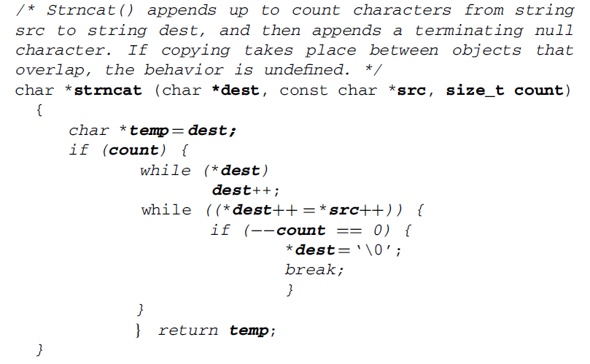
Sizing – „the old way” – lines of code
How many lines are in STRNCAT function
Depends ☺
Notes:
What number did you come up with? What rules did you decide to use? In experiments with students, the answers range from 11 to 19, with occasional counts over 100 if the data definitions are included. As with most everything, it depends on how you count and what the rules are. Did you count comment lines? Did you count lines with just a “g”? If instead, we have a well-specified model that tells us “the rules,” then, counting lines becomes simple, and the students all arrive at the same answer.

Slide 20
Sizing – „the old way” – lines of code
Original method of estimating size
Program Size = LOC needed for functionality
How many LOC from the experiment?
The world may never know…

Slide 21

Calculating the LOC Estimate
$$Est.LOC=\frac{4\left(likely LOC\right)+minimum LOC+maximum LOC}{6}$$
Alternative – Average between Min. and Max. LOC
Module 1 Estimated LOC
Functionality | Min LOC | Max. LOC | Likely LOC | Estimated LOC
F1 | 100 | 150 | 125 | 140
F2 | 95 | 120 | 105 | 105
TOTAL |  |  |  | 245

Slide 22
LOC – Pros/Cons
Pros
Beneficial for Real Time/Embedded Applications
Can be used to create Historical data for future estimates
Easy to count
Cons
No defined “Line”
Doesn’t promote code optimizations

Slide 23
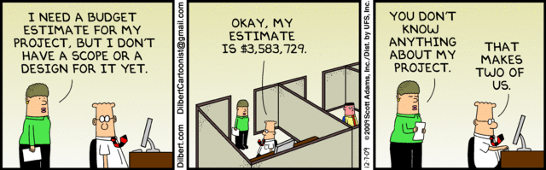
Estimating the effort
Person Hours/Months/[Unit of time]
Derives Schedule, Cost…

Slide 24
Method - Analogy
How it’s done:
Use knowledge of previous projects to come up with estimates
What is needed for success:
Company must keep records
Similar Projects must have been made

Slide 25
Method - Analogy
Parameters for Analyzing
Project Type
Full life cycle
Implementation
Conversion
Port
Migration
Client Information
Application Domain
Size of client’s organization
Number of client locations
Development Platform

Slide 26
Analogy – Strengths/Weaknesses
Strengths:
Reliable
Intuitive
Estimation Data can be purchased
Weaknesses
Poor Record Keeping = bad estimates
Not the best for new organizations
Time consuming

Slide 27
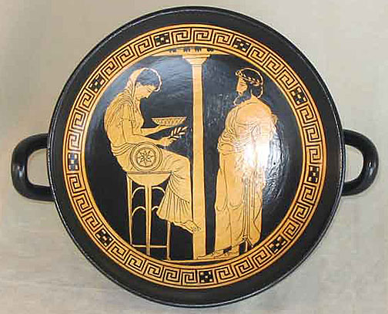
Method – Expert Judgement ( Delphi )
How it’s done:
Work with Subject Matter Experts (SMEs) to formulate estimates
If a small team of SMEs is used, a common estimate is derived
Works well because:
No historical data needed
If proper SME is chosen -
Extremely accurate
Quick
Inaccurate because:
SME can be biased / inconsistent / overconfident

Slide 28
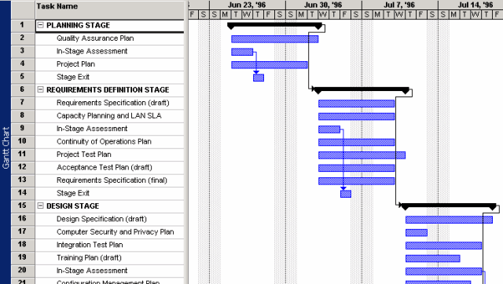
Methods: Activity and Work Decomposition

Slide 29
Methods: Activity and Work Decomposition
How it’s done:
Outline the needed tasks involved for the project
Should be done by person who ensures the tasks are accomplished.
Use knowledge of needed work and skill set of the implementers to derive time estimates.
Pros:
Estimator is knowledgeable of the work at hand
No explicit sizing such as Lines of Code count is needed
Limitations:
Subjective – accuracy is up to the estimator’s opinion
No sizing

Slide 30
Methods: Top-Down
How it’s done:
Decomposition of system into smaller components
Works well because:
Estimates are linked to requirements
Inaccurate when:
Good requirements aren’t available
Bias may lead to underestimation

Slide 31
Methods: Bottom-Up
How it’s done:
Individuals evaluate each component of the entire system.
Sum to formulate project estimate
Works well because:
Can be very accurate – detailed
Builds responsibility
Issues:
Time consuming process
Details may not be available
Bias can lead to underestimation
Can miss integration costs

Slide 32
Methods: Design To Cost
How it’s done:
Work with SMEs to find out how much we can give the customer for given budget
Works well because:
The price is right!
Issues:
Need knowledge of functionality cost

Slide 33

Estimating…Uncertainty?

Slide 34
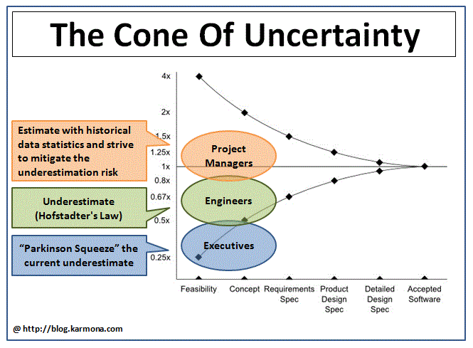
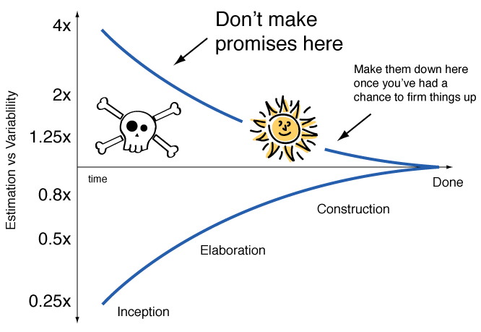
The Cone of Uncertainty
400% to 25% !?
Current studies show closer to +100% / -50% at feasibility stage
Strong tendency to underestimate

Slide 35
Acknowledging Uncertainty
Alternatives to giving a single number
Between X and Y person months
X% chance it will be under Y person months
Use the “pX” approach
“X” = X% chance of NOT exceeding the estimate
Example – You’re on a project and your estimate is 8 person months. You’ve researched that 10% of similar projects have been under budget.
p10 estimate = 7 staff months – 10% chance of being under, 90% being over

Slide 36
Dealing with Uncertainties
Communicate in a way that makes them known, such as the pX method.
Methodology > Gut Feelings
Work pressure drives over confidence
Re-Estimate
Feasibility Stage - Ball Park
Requirements Stage – More Detailed
Design Stage - Refined
Agile Environments:
Expect higher uncertainty

Slide 37
And now…Let’s get seriouS
The true measure of a man is what he would do if he knew he would never be caught
Lord Kelvin

Slide 38
Methods: Parametric Models
How it’s done:
Estimate by use of design parameters and mathematic formulas
Works well because:
Fast
Ease of use
Can be re-useable
Issues:
Models need to “fit the bill”
Can end up being very inaccurate through poor choice of parameters

Slide 39
COCOMO (COnstructive COst MOdel)
Developed by Barry Boehm in 1981
Also called COCOMO I or Basic COCOMO
Top-down approach to estimate cost, effort and schedule of software projects, based on size and complexity of projects
Assumptions:
Derivability of effort by comparing finished projects (“COCOMO database”)
System requirements do not change during development
Exclusion of some efforts (for example administration, training, rollout, integration).

Slide 40
Calculation of Effort
Estimate number of instructions
KDSI = “Kilo Delivered Source Instructions”
Determine project complexity parameters: A, B
Regression analysis, matching project data to equation
3 levels of difficulty that characterize projects – templates for companies that don’t have resources for their A/B calculations
Simple project (“organic mode”)
Semi-complex project (“semidetached mode”)
Complex project (“embedded mode”)
Calculate effort
Effort = A * KDSI^{B}
Also called Basic COCOMO
Notes:
A and B can be determined by a curve fit procedure (regression analysis), matching project data to the equation (this is how you calibrate your data to the Cocomo model)
But most organizations do not have enough data to perform such an analysis
So Boehm has identified three levels of difficulty that seem to characterize many software projects
A further COCOMO assumption:
1 staff month = 152 productive hours (8 hours per day, 19 days/month), (less weekends, holidays, etc.)
Simple: small developer groups work on a well known problem
Semi-complex: complexity between „simple“ and „complex“, either unknown problem or large group of developers
Complex: large groups of developers, Problem domain unknown
[PM] means „person months“
By using cost drivers, in many cases a more accurate estimate is possible

Slide 41
Calculation of Effort in Basic COCOMO
Formula: Effort = A * KDSI^{B}
Effort is counted in person months: 152 productive hours (8 hours per day, 19 days/month, less weekends, holidays, etc.)
A, B are constants based on the complexity of the project
Project Complexity | A | B
Simple | 2.4 | 1.05
Semi-Complex | 3.0 | 1.12
Complex | 3.6 | 1.20
Notes:
A and B can be determined by a curve fit procedure (regression analysis), matching project data to the equation (this is how you calibrate your data to the COCOMO model). But most organizations do not have enough data to perform such an analysis
So Boehm has identified three levels of difficulty that seem to characterize many software projects
A further COCOMO assumption: 1 staff month = 152 productive hours
(8 hours per day, 19 days/month)
(less weekends, holidays, etc.)

Slide 42
Calculation of Development Time
Basic formula: T = C * Effort^{D}
T = Time to develop in months
C, D = constants based on the complexity of the project
Effort = Effort in person months (see slide before)
Project Complexity | C | D
Simple | 2.5 | 0.38
Semi-Complex | 2.5 | 0.35
Complex | 2.5 | 0.32

Slide 43
Basic COCOMO Example
Volume = 30000 LOC = 30KLOC
Project type = Simple
Effort = 2.4 * (30)^{1.05} = 85 PM
Development Time = 2.5 * (85)^{0.38} = 13.5 months
=> Avg. staffing: 85/13.5 = 6.3 persons
=> Avg. productivity: 30000/85 = 353 LOC/PM

Slide 44
Other COCOMO Models
Intermediate COCOMO
15 additional cost drivers ( parameters ) yielding a multiplicative correction factor
Basic COCOMO is based on value of 1.00 for each of the cost drivers
Detailed COCOMO
Multipliers depend on phase: Requirements; System Design; Detailed Design; Code and Unit Test; Integrate & Test; Maintenance

Slide 45
Steps in Intermediate COCOMO
Basic COCOMO steps
Estimate number of instructions
Determine project complexity parameters: A, B
Determine level of difficulty that characterizes the project
New step
Determine cost drivers
15 cost drivers c1 , c1 …. c15
Calculate effort
Effort = A * KDSI^{B} * c1 * c1 …. * c15
Notes:
A and B can be determined by a curve fit procedure (regression analysis), matching project data to the equation
(this is how you calibrate your data to the Cocomo model)
But most organizations do not have enough data to perform such an analysis
So Boehm has identified three levels of difficulty that seem to characterize many software projects
A further COCOMO assumption:
1 staff month = 152 productive hours
(8 hours per day, 19 days/month)
(less weekends, holidays, etc.)
Simple: small developer groups work on a well known problem
Semi-complex: complexity between „simple“ and „complex“, either unknown problem or large group of developers
Complex: large groups of developers, Problem domain unknown
[PM] means „person months“
By using cost drivers, in many cases a more accurate estimate is possible

Slide 46
Calculation of Effort in Intermediate COCOMO
Basic formula:
Effort = A * KDSI^{B} * c₁ * c₁ ….* c₁₅
Effort is measured in PM (person months, 152 productive hours (8 hours per day, 19 days/month, less weekends, holidays, etc.)
A, B are constants based on the complexity of the project
Project Complexity | C | D
Simple | 2.4 | 1.05
Semi-Complex | 3.0 | 1.12
Complex | 3.6 | 1.20
Notes:
A and B can be determined by a curve fit procedure (regression analysis), matching project data to the equation (this is how you calibrate your data to the COCOMO model). But most organizations do not have enough data to perform such an analysis
So Boehm has identified three levels of difficulty that seem to characterize many software projects
A further COCOMO assumption: 1 staff month = 152 productive hours
(8 hours per day, 19 days/month)
(less weekends, holidays, etc.)

Slide 47
Intermediate COCOMO: 15 Cost drivers
Product Attributes
Required reliability
Database size
Product complexity
Computer Attributes
Execution Time constraint
Main storage constraint
Virtual Storage volatility
Turnaround time
Personnel Attributes
Analyst capability
Applications experience
Programmer capability
Virtual machine experience
Language experience
Project Attributes
Use of modern programming practices
Use of software tools
Required development schedule
Rated on a qualitative scale between "very low" and "extra high„
Associated values are multiplied with each other

Slide 48
COCOMO II
Revision of COCOMO I in 1997
Provides three models of increasing detail
Application Composition Model
Estimates for prototypes based on GUI builder tools and existing components
Early Design Model
Estimates before software architecture is defined
For system design phase, closest to original COCOMO, uses function points as size estimation
Post Architecture Model
Estimates once architecture is defined
For actual development phase and maintenance; Uses FPs or SLOC as size measure
Estimator selects one of the three models based on current state of the project

Slide 49
COCOMO II
Targeted for iterative software lifecycle models
Boehm’s spiral model
COCOMO I assumed a waterfall model
30% design; 30% coding; 40% integration and test
COCOMO II includes new costs drivers to deal with
Team experience
Developer skills
Distributed development
COCOMO II includes new equations for reuse
Enables build vs. buy trade-offs

Slide 50
COCOMO II: Added Cost drivers
Development flexibility
Team cohesion
Developed for reuse
Precedent
Architecture & risk resolution
Personnel continuity
Documentation match life cycle needs
Multi-Site development

Slide 51
Advantages of COCOMO
Appropriate for a quick, high-level estimation of project costs
Fair results with smaller projects in a well known development environment
Assumes comparison with past projects is possible
Covers all development activities (from analysis to testing)
Intermediate COCOMO yields good results for projects on which the model is based

Slide 52
Problems with COCOMO
Judgment requirement to determine the influencing factors and their values
Experience shows that estimation results can deviate from actual effort by a factor of 4
Some important factors are not considered:
Skills of team members, travel, environmental factors, user interface quality, overhead cost

Slide 53
Problems with COCOMO
Judgment requirement to determine the influencing factors and their values
Experience shows that estimation results can deviate from actual effort by a factor of 4
Some important factors are not considered:
Skills of team members, travel, environmental factors, user interface quality, overhead cost

Slide 54
Function Point Analysis
Developed by Allen Albrecht, IBM Research, 1979
Technique to determine size of software projects
Size is measured from a functional point of view
Estimates are based on functional requirements
Albrecht originally used the technique to predict effort
Size is usually the primary driver of development effort
Notes:
Size is measured from a functional point of view, not from a task view. In that sense function point analysis focuses more on the functional model (requirements analysis) than on the task model (project management). In other words, estimates are based on the users view of the functionality , not the developers view.
However, the types of functions that Albrecht had in mind were transactions in a functionally decomposed system. Whether function points can be used to count use cases is an open question.
Function points are not a perfect measure of effort to develop an application or of its business value, although the size in function points is typically an important factor in measuring each. This is often illustrated with an analogy to the building trades. A three thousand square foot house is usually less expensive to build one that is six thousand square feet. However, many attributes like marble bathrooms and tile floors might actually make the smaller house more expensive. Other factors, like location and number of bedrooms, might also make the smaller house more valuable as a residence.
Historical note (From Ray Boehm: http://ourworld.compuserve.com/homepages/softcomp/fpfaq.htm)
In the late seventies, IBM felt the need to develop a language independent approach to estimating software development effort. It tasked one of its employees, Allan Albrecht, with developing this approach. The result was the function point technique. In the early eighties, the function point technique was refined and a counting manual was produced by IBM's GUIDE organization. The International Function Point Users Group (IFPUG) was founded in the late eighties. This organization produced its own Counting Practices Manual. In 1994, IFPUG produced Release 4.0 of its Counting Practices Manual.

Slide 55
Function Point Analysis
Independent of
Implementation language and technology
Development methodology
Capability of the project team
A top-down approach based on function types
Three steps: Plan the count, perform the count, estimate the effort.

Slide 56
Steps in Function Point Analysis
Plan the count
Type of count: development, enhancement, application
Identify the counting boundary
Identify sources for counting information: software, documentation and/or expert
Perform the count
Count data access functions
Count transaction functions
Notes:
Function Point Analysis is based on a functional decomposition of the system into input, transformation and output functions.
The Analysis consists of two steps: Planning the count, and performing the count.
A) Plan the Count. This step includes two steps: 1) determine the type of count, and 2) identify counting boundary. It also includes critical logistics around the identification of counting information.
There are three types of counts: development project counts, enhancement project counts and application counts. The development project count also yields the first application count for an application.
Identifying the counting boundary can be complicated. In some cases, changing the counting boundary will make it necessary to do a different type of function point count. For example, what appeared to be a development project count was actually an application count followed by an enhancement project count.
There are three sources for counting information: the system to be counted, its documentation and the system expert (Application domain or solution domain expert). These sources are in increasing order of value to the counting process. One can perform a system count only with access to the system (software): this is usually very time consuming. Counting from the documentation is usually fast if the documentation is complete and easy to understand: It never is! The system expert can walk you through the other information and answer questions as they arise during the count. In function point analysis it is important, to get a system expert assigned with the counter for the entire count. Identification of the appropriate system expert is not always easy. It also depends on the counting boundary. An expert for one component of an application may be unaware of the particulars of other components.
Nevertheless, the system expert is often the application domain expert or the software architect. It may also be an end user who is very familiar with the application. It is usually not the project manager. Interestingly enough, the project manager is usually more willing to work with you directly than to assign the system expert.
B) Do the Count:
1.Count data function types. Data functions are either accessing Internal Logical Files (ILFs) or External Interfaces Files (EIFs). The count of the ILFs and EIFs is done by examining the data model (E/R model or the attributes of the persistent objects in the object model) or by asking the system designer for the application’s main categories of persistent data. This count must be done before the transactions function types are counted, because the complexity of the transactions is dependent on the way the data access functions are identified.
2. Count the transaction function types. Transaction function types are External Inputs (EIs), External Outputs (EOs) or External Queries (EQs). This is typically the longest part of the count, and the part where the system expert's assistance really saves time. Complexity of each transaction is based, in part, on the number of data types it references. The system expert can usually make this determination without consulting any documentation.
3. Compute the Unadjusted function points based on weight factors shown on the next slide.
4.Next we assign rating values 0 to 5 to the so called GSC factors (general system complexity factors). There are 14 GSC factors
shown on the next slide.
5. We sum up all 14 weighted GSC factors and compute the so called valued added factor (VAF). The formula is
VAF = 0.65 + (sum of all GSC factors/100).
6. Next we calculate the Adjusted function points = VAF * Unadjusted function points
7. Then we make a estimation how many function points we can finish per day. This is also called as "Performance factor"･
8. On the basis of the performance factor we calculate the effort in Person Days.

Slide 57
Steps in Function Point Analysis
Estimate the effort
Compute the unadjusted function points (UFP)
Compute the Value Added Factor (VAF)
Compute the adjusted Function Points (FA)
Compute the performance factor
Calculate the effort in person days
Notes:
Function Point Analysis is based on a functional decomposition of the system into input, transformation and output functions.
The Analysis consists of two steps: Planning the count, and performing the count.
A) Plan the Count. This step includes two steps: 1) determine the type of count, and 2) identify counting boundary. It also includes critical logistics around the identification of counting information.
There are three types of counts: development project counts, enhancement project counts and application counts. The development project count also yields the first application count for an application.
Identifying the counting boundary can be complicated. In some cases, changing the counting boundary will make it necessary to do a different type of function point count. For example, what appeared to be a development project count was actually an application count followed by an enhancement project count.
There are three sources for counting information: the system to be counted, its documentation and the system expert (Application domain or solution domain expert). These sources are in increasing order of value to the counting process. One can perform a system count only with access to the system (software): this is usually very time consuming. Counting from the documentation is usually fast if the documentation is complete and easy to understand: It never is! The system expert can walk you through the other information and answer questions as they arise during the count. In function point analysis it is important, to get a system expert assigned with the counter for the entire count. Identification of the appropriate system expert is not always easy. It also depends on the counting boundary. An expert for one component of an application may be unaware of the particulars of other components.
Nevertheless, the system expert is often the application domain expert or the software architect. It may also be an end user who is very familiar with the application. It is usually not the project manager. Interestingly enough, the project manager is usually more willing to work with you directly than to assign the system expert.
B) Do the Count:
1.Count data function types. Data functions are either accessing Internal Logical Files (ILFs) or External Interfaces Files (EIFs). The count of the ILFs and EIFs is done by examining the data model (E/R model or the attributes of the persistent objects in the object model) or by asking the system designer for the application’s main categories of persistent data. This count must be done before the transactions function types are counted, because the complexity of the transactions is dependent on the way the data access functions are identified.
2. Count the transaction function types. Transaction function types are External Inputs (EIs), External Outputs (EOs) or External Queries (EQs). This is typically the longest part of the count, and the part where the system expert's assistance really saves time. Complexity of each transaction is based, in part, on the number of data types it references. The system expert can usually make this determination without consulting any documentation.
3. Compute the Unadjusted function points based on weight factors shown on the next slide.
4.Next we assign rating values 0 to 5 to the so called GSC factors (general system complexity factors). There are 14 GSC factors
shown on the next slide.
5. We sum up all 14 weighted GSC factors and compute the so called valued added factor (VAF). The formula is
VAF = 0.65 + (sum of all GSC factors/100).
6. Next we calculate the Adjusted function points = VAF * Unadjusted function points
7. Then we make a estimation how many function points we can finish per day. This is also called as "Performance factor"･
8. On the basis of the performance factor we calculate the effort in Person Days.

Slide 58
Function Types
Data function types
# of internal logical files (ILF)
# of external interface files (EIF)
Transaction function types
# of external input (EI)
# of external output (EO)
# of external queries (EQ)
Calculate the UFP (unadjusted function points):
UFP = a · EI + b · EO + c · EQ + d · ILF + e · EIF
a-f are unadjusted weight factors (see next slide)
Notes:
There are two ways to count functions. The first way is the traditional Albrecht approach based on the analysis of transactions. The second way is based on the data modeling approach (E/R model).
To do the count, the FP counter has to do the following three steps:
1.Count data function types. Data functions are either accessing Internal Logical Files (ILFs) or External Interfaces Files (EIFs). The count of the ILFs and EIFs is done by examining the data model (E/R model or the attributes of the persistent objects in the object model) or by asking the system designer for the application’s main categories of persistent data. This count must be done before the transactions function types are counted, because the complexity of the transactions is dependent on the way the data access functions are identified.
2. Count the transaction function types. Transaction function types are External Inputs (EIs), External Outputs (EOs) or External Queries (EQs). This is typically the longest part of the count, and the part where the system expert's assistance really saves time. Complexity of each transaction is based, in part, on the number of data types it references. The system expert can usually make this determination without consulting any documentation.
3. Compute the Unadjusted function points based on weight factors shown on the next slide.

Slide 59
Object Model Example
Customer
Name
Address
Amound Due
Place
Location
Space
Item
Description
Pallets
Value
Storage Date
Owner
Storage Place
1
1
owns
*
*
Stored at

Slide 60
Calculate the Unadjusted Function Points
Weight Factors
Function Type
Number
simple
average
complex
External Input (EI)
x
3
4
6
=
External Output (EO)
x
4
5
7
=
External Queries (EQ)
x
3
4
6
=
Internal Datasets (ILF)
x
7
10
15
=
Interfaces (EIF)
x
5
7
10
=
Unadjusted Function Points (UFP)
=
Notes:
After we have counted the ILF,EIF,EI and Eqs, we can compute the unadjusted function points UFP shown on this slide.
In function point analysis, each type of function (input, output, inquiry, file) is first assigned a 'complexity' weighting (simple, average, complex), suggesting that functional size is measured on an ordinal scale.
Next, a specific number of function points are allocated to each function depending on its type and complexity weighting. Within each set of functions belonging to a same type, the allocation of integer values to functions qualifies as an admissible transformation of scale.
The higher the complexity weighting, the more function points are allocated. For instance, external input functions get 3 function points if they are simple, 4 function points if they are of average complexity, and 6 function points if they are complex. Hence, within the class of input functions, one ordinal scale (simple, average, complex) is homomorphically transformed into another ordinal scale (3, 4, 6).
Next, the function points assigned to all individual functions are summed to arrive at the 'unadjusted function point count' for the entire system.
Note, that this operation is not meaningful given the ordinal scale type of the homomorphisms (one per function type) that allocate function point values to functions, but we don’t look into this argument here.

Slide 61
Mapping Functions to Transaction Types
Add Customer
Change Customer
Delete Customer
Receive payment
Deposit Item
Retrieve Item
Add Place
Change Place Data
Delete Place
Print Customer item list
Print Bill
Print Item List
Query Customer
Query Customer's items
Query Places
Query Stored Items
External Inputs
External Outputs
External Inquiries

Slide 62
Advantages of Function Point Analysis
Independent of implementation language and technology
Estimates are based on design specification
Usually known before implementation tasks are known
Users without technical knowledge can be integrated into the estimation process
Incorporation of experiences from different organizations
Easy to learn
Limited time effort
Notes:
Function Points measure software size independent of the programming language: no lines of code counting.
Function Points measure functionality by objectively measuring functional requirements.
Function Point Analysis is objective; Function Points are consistent, and Function Points are auditable.
Function Points are independent of technology. Function Points even apply regardless of design.

Slide 63
Disadvantages of Function Point Analysis
Complete description of functions necessary
Often not the case in early project stages -> especially in iterative software processes
Only complexity of specification is estimated
Implementation is often more relevant for estimation
High uncertainty in calculating function points:
Weight factors are usually deducted from past experiences (environment, used technology and tools may be out-of-date in the current project)
Does not measure the performance of people
Notes:
Code reuse and external providers of software components are not considered
Function Points do not measure people directly.
Task planning and controlling is not possible (also: no breakdown to single project phases considered)
Function Points is a macro tool, not a micro tool.

Slide 64
Online Availability of Estimation Tools
Basic and Intermediate COCOMO I (JavaScript)
http://www1.jsc.nasa.gov/bu2/COCOMO.html
http://ivs.cs.uni-magdeburg.de/sw-eng/us/java/COCOMO/index.shtml
COCOMO II (Unix, Windows and Java)
http://sunset.usc.edu/available_tools/index.html
Function Point Calculator (Java)
http://ivs.cs.uni-magdeburg.de/sw-eng/us/java/fp/

Slide 65
Why Estimates Fail – A recap
Little / Misused historical data
Record estimates + actual data
Make sure data “fits the bill”
Over-Optimistic / Hopeful management
Avoid gut feelings – use the methods
Avoid over-confidence
Not using the estimate!
Don’t Confuse targets with estimates
Not updating the estimate
Acknowledge uncertainty in estimation
Estimate often – it will become more accurate

Slide 66
What’s next
Cost
Personnel (in person days or valued in personnel cost)
Person day: Effort of one person per working day
Material (PCs, software, tools etc.)
Extra costs (travel expenses etc.)
Development Time
Project duration
Dependencies
Infrastructure
Rooms, technical infrastructure, especially in offshore scenarios
All of this + cost advanced topics

Slide 67
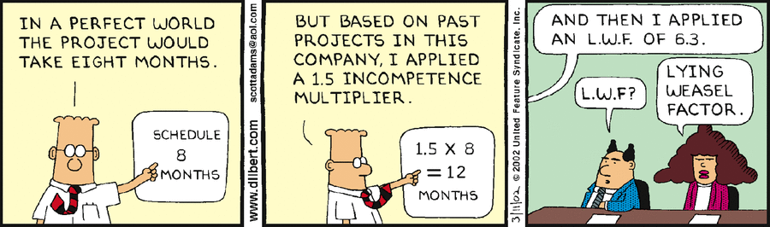
L.W.F Factor

Slide 68

Thank you for your time

